Slide 1
Retire the news release. Hire the News Bureau!
Roseann Canfora, Ph.D.
Chief Communications Officer
Cleveland Metropolitan School District

Slide 2
Telling our own stories…

Slide 4
#1: Know your audience

Slide 5
2. Identify their
challenges and opportunities

Slide 6
#3
Offer them something of value

Slide 7
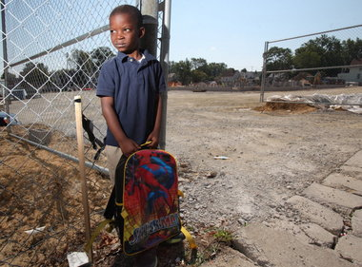

Slide 8
Eugene Johnson's first day of kindergarten was a complete disaster: Phillip Morris
CLEVELAND PLAIN DEALER: August 25, 2012

Slide 11
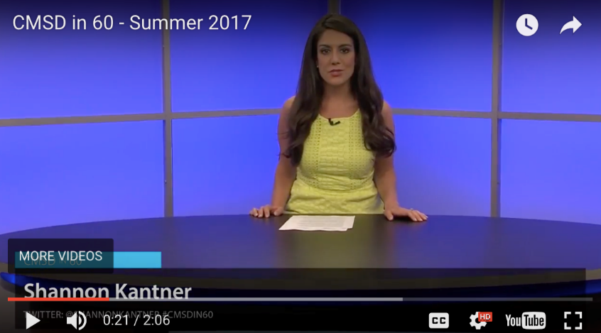
http://clevelandmetroschools.org/site/default.aspx?PageType=3&DomainID=4&ModuleInstanceID=15675&ViewID=047E6BE3-6D87-4130-8424-D8E4E9ED6C2A&RenderLoc=0&FlexDataID=14834&PageID=1

Slide 12
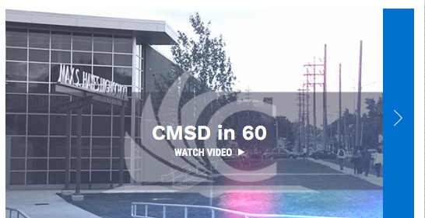
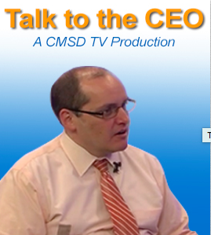

Slide 13
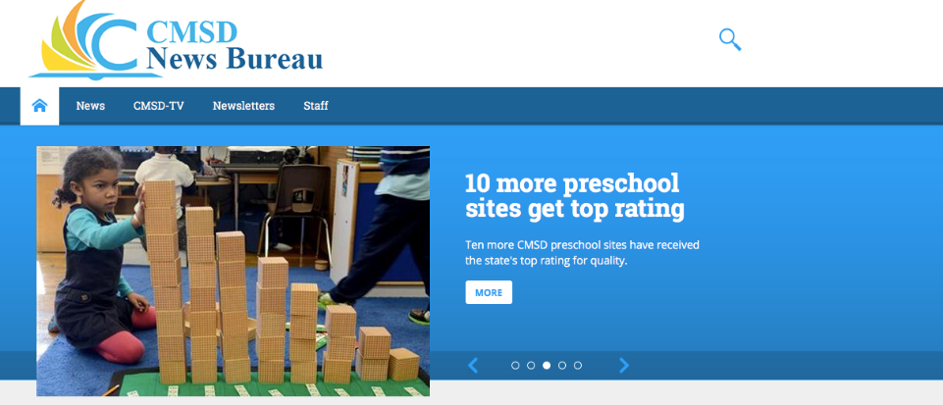

Slide 15
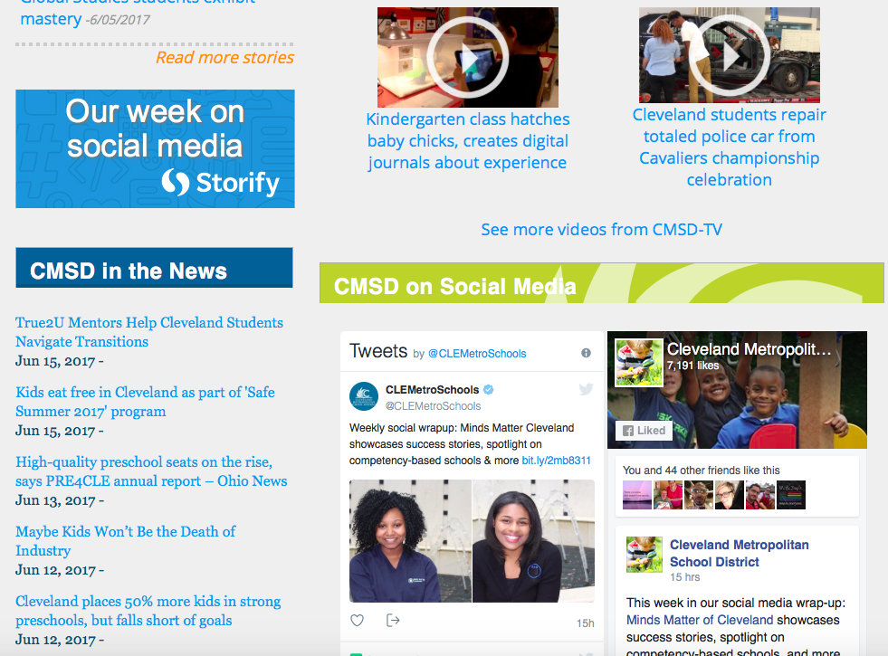

Slide 16
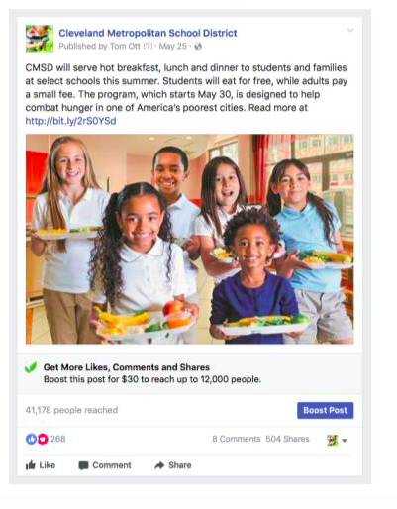
Top 5 posts on CMSD Facebook
41,178
504 shares

Slide 17
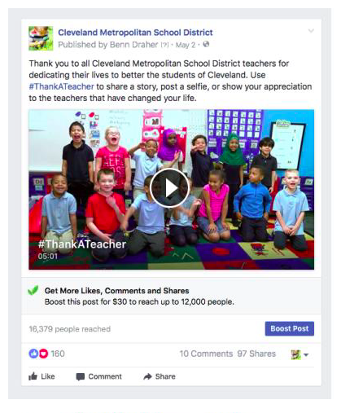
Thank a Teacher
16,379
97 shares

Slide 18
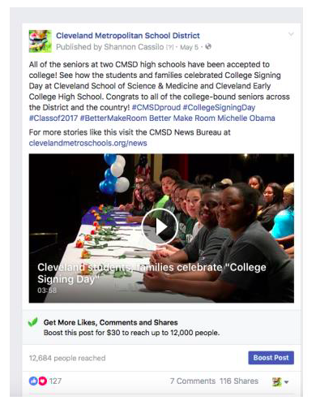
College Signing Day
12, 684
116 shares

Slide 19
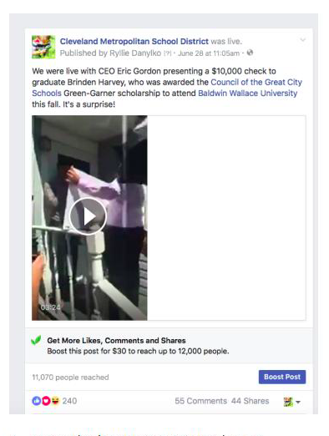
“Big Check” Scholarship
11,070
44 shares

Slide 20
10 Preschools earn Top Ratings
9,866
29 shares

Slide 21
Clevelandmetroschools.org/news

